Slide 1

Data Acquisition of Solar Panel
Group ID C-08
Saadain Shaikh - B190333204
Vipulkumar Patil - B190333163
Aditya Karale - B190333103
Guided by Prof. A. B. Patil
ELECTRONICS & TELECOMMUNICATION ENGINEERING
Pimpri Chinchwad College of Engineering , Pune

Slide 2
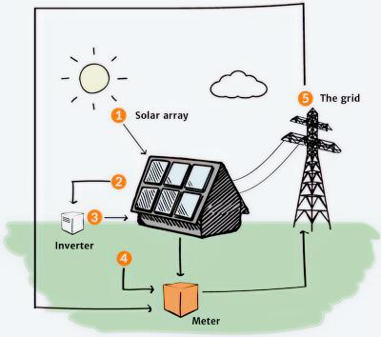
OUTLINE OF PROJECT
Introduction
Problem Statement, Objectives
Literature Survey
Methodology
Software
Hardware
Results
Advantages
Applications
Conclusion
References

Slide 3
Introduction
Renewable energy has vast potential in modern technologies. Solar energy is an example of renewable energy which is now becoming a common energy source for household consumption, battery chargers, and public illumination.
PV solar cells or modules are being used to harness the solar energy.
New markets are becoming more accessible as technology for PV cells and systems advances.
To accurately anticipate the solar PV energy potential under varied climatic circumstances, a simulation model having physical parameters such as solar irradiance and temperature is in much need.

Slide 4
Problem Statement, Objectives
Problem Statement
To acquire the real-time data of various parameters related to solar panel and compare it with the simulated data.
Objective
To simulate the solar panel system using MATLAB-Simulink.
To implement the hardware system required for demonstrating the solar panel system.
To measure the various parameters such as generated voltage, current, light power, and irradiance.
To compare the real-time data with simulated results.

Slide 5
Literature Survey
Sr. No. | Title of Paper | Year of Publication | Publisher | Methodology | Conclusion
1 | Data Acquisition System for Solar Panels | 2019 | International Spring Seminar on Electronics Technology | Clear sky radiation prediction and visualizing time series data using Grafana and influx DB | Developed the foundation for an open-source multi-protocol environmental monitoring solution used purposely for solar energy generation optimization.
2 | Design Of Photo Voltaic Solar Cell Model for Standalone Renewable System | 2014 | IEEE International ELEKTRO Conference | MATLAB modelling of single diode equivalent circuit of the PV solar cell | This model of the PV solar module was based on fundamental circuit equations of PV solar cells. Simulations in MATLAB were used for verification.
3 | Five-Parameter Model of Photovoltaic Cell Based on STC Data and Dimensionless | 2012 | IEEE 27th Convention of Electrical and Electronics Engineers | Considers parameters - photocurrent, reverse bias saturation current, idealist factor, band gap energy, the temperature coefficient of the photo-generating current. | The improved method for determination of parameters of the single-diode photovoltaic cell model was developed.

Slide 6
Literature Survey
Sr. No. | Title of Paper | Year of Publication | Publisher | Methodology | Conclusion
4 | PV Panel Model Based on Datasheet Values | 2007 | IEEE International Symposium on Industrial Electronics | Construction of a model for a PV panel using the single-diode five-parameters model, based exclusively on data-sheet parameters | A model for photovoltaic panels, based exclusively on datasheet parameters has been developed and implemented.
5 | A Simple and Accurate Model of Photovoltaic Modules For Power System Design | 2007 | IEEE International Symposium on Industrial Electronics | Simulation results of five lumped parameter model and four lumped parameter model along with manufacturers' curves are compared to test the accuracy | A modelling technique for PV panels to power electronics design has been proposed and analysed in detail.

Slide 7
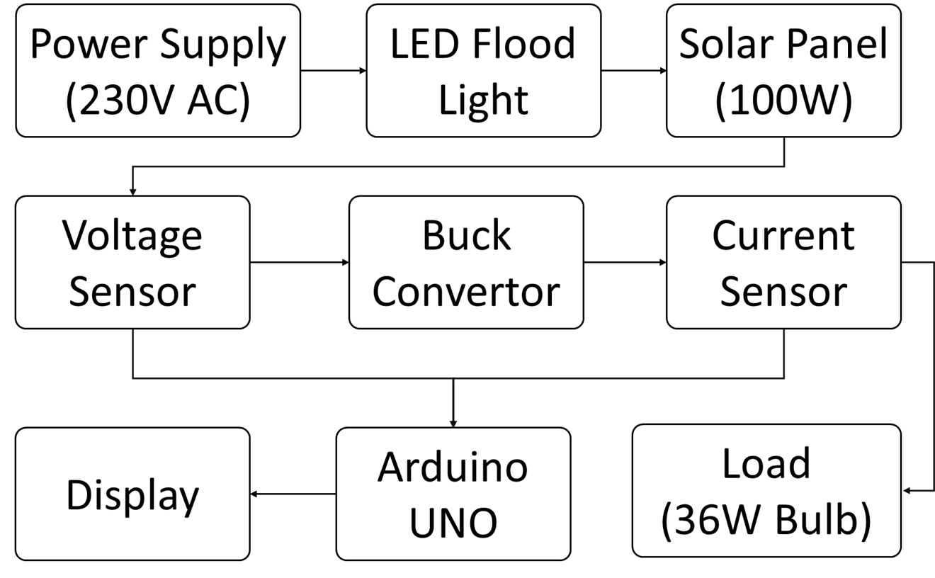
Methodology
Block Diagram

Slide 8
Software Implementation
Software Used :
MATLAB Simulink
EasyEDA
Arduino IDE
PuTTY

Slide 9
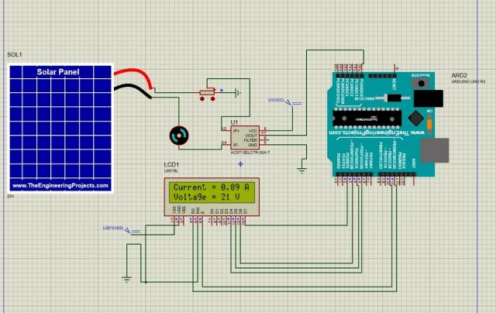
Circuit Diagram

Slide 10
Algorithm of Arduino Code
Define the analog pin to read potential as "analogInput" (A1).
Declare and initialize variables: "vout" and "vin" as floats, "R1" and "R2" as resistance values, and "adcValue" as an integer.
In the setup function:
Set the analog input pin (analogInput) as input using pinMode.
Start the serial communication with a baud rate of 9600 using Serial.begin.
Print a message on the serial monitor to indicate that the device is ready using Serial.println.
In the loop function:
Read the analog input from pin A0 and store the value in adcValue.
Convert the ADC value to voltage using the formula: voltage = adcValue * 5 / 1023.0.
Calculate the current based on the voltage using the formula: current = (voltage - 2.5) / 0.1.
Print the current value on the serial monitor using Serial.print and Serial.println.
Read the voltage from the analog input pin (analogInput) and store the value in adcValue.
Convert the ADC value to voltage using the formula: vout = (adcValue * 5.0) / 1024.0.
Calculate the input voltage (vin) based on the voltage divider formula: vin = vout / (R2 / (R1 + R2)).
Calculate the power based on the voltage and current values using the formula: power = current * vin.
Print the input voltage and power on the serial monitor using Serial.print and Serial.println.

Slide 11
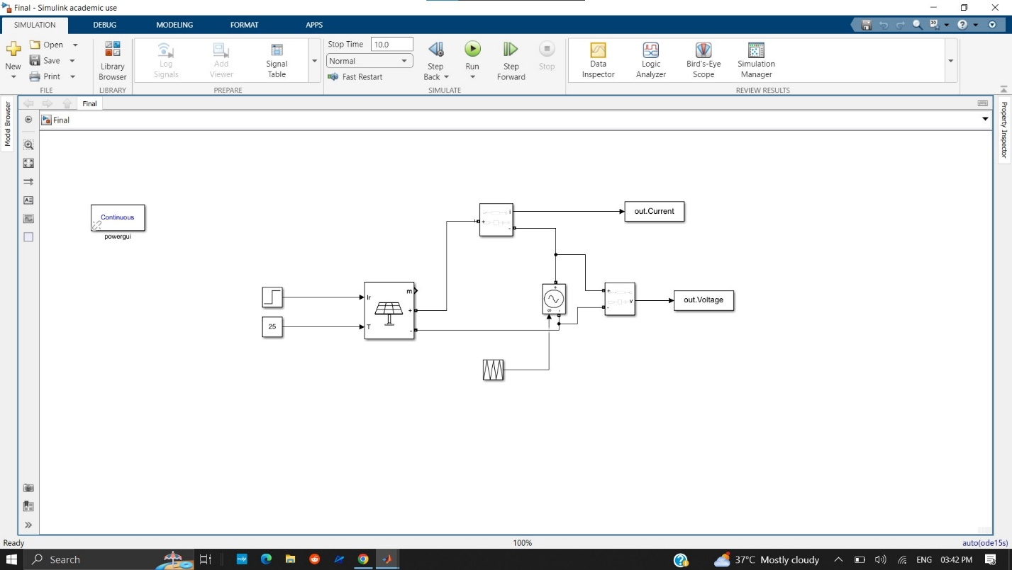
MATLAB Simulation
Mathematical Modeling of Solar Panel Module

Slide 12
Equations for Mathematical Modeling
Saturation current
Reverse Saturation Current

Slide 13
Equations for Mathematical Modeling
Photo-Current
Shunt-Current

Slide 14
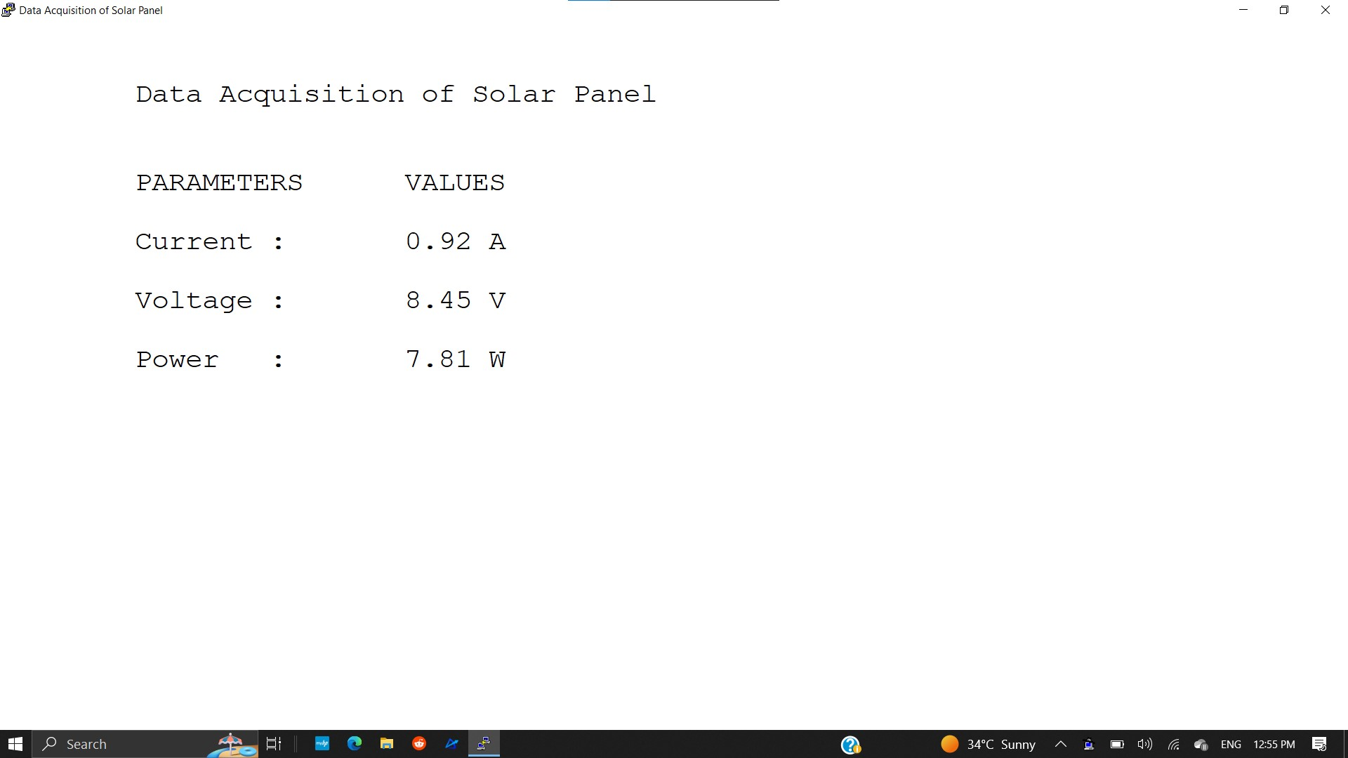
Graphical User Interface (GUI)

Slide 15
Hardware Implementation
Hardware Used :
Solar Panel (100W)
PWM Controller(4000W)
LED Flood Light(100W)
Arduino UNO
Current Sensor
Voltage Sensor
Buck Convertor
DC Bulb(12W) x 3

Slide 16
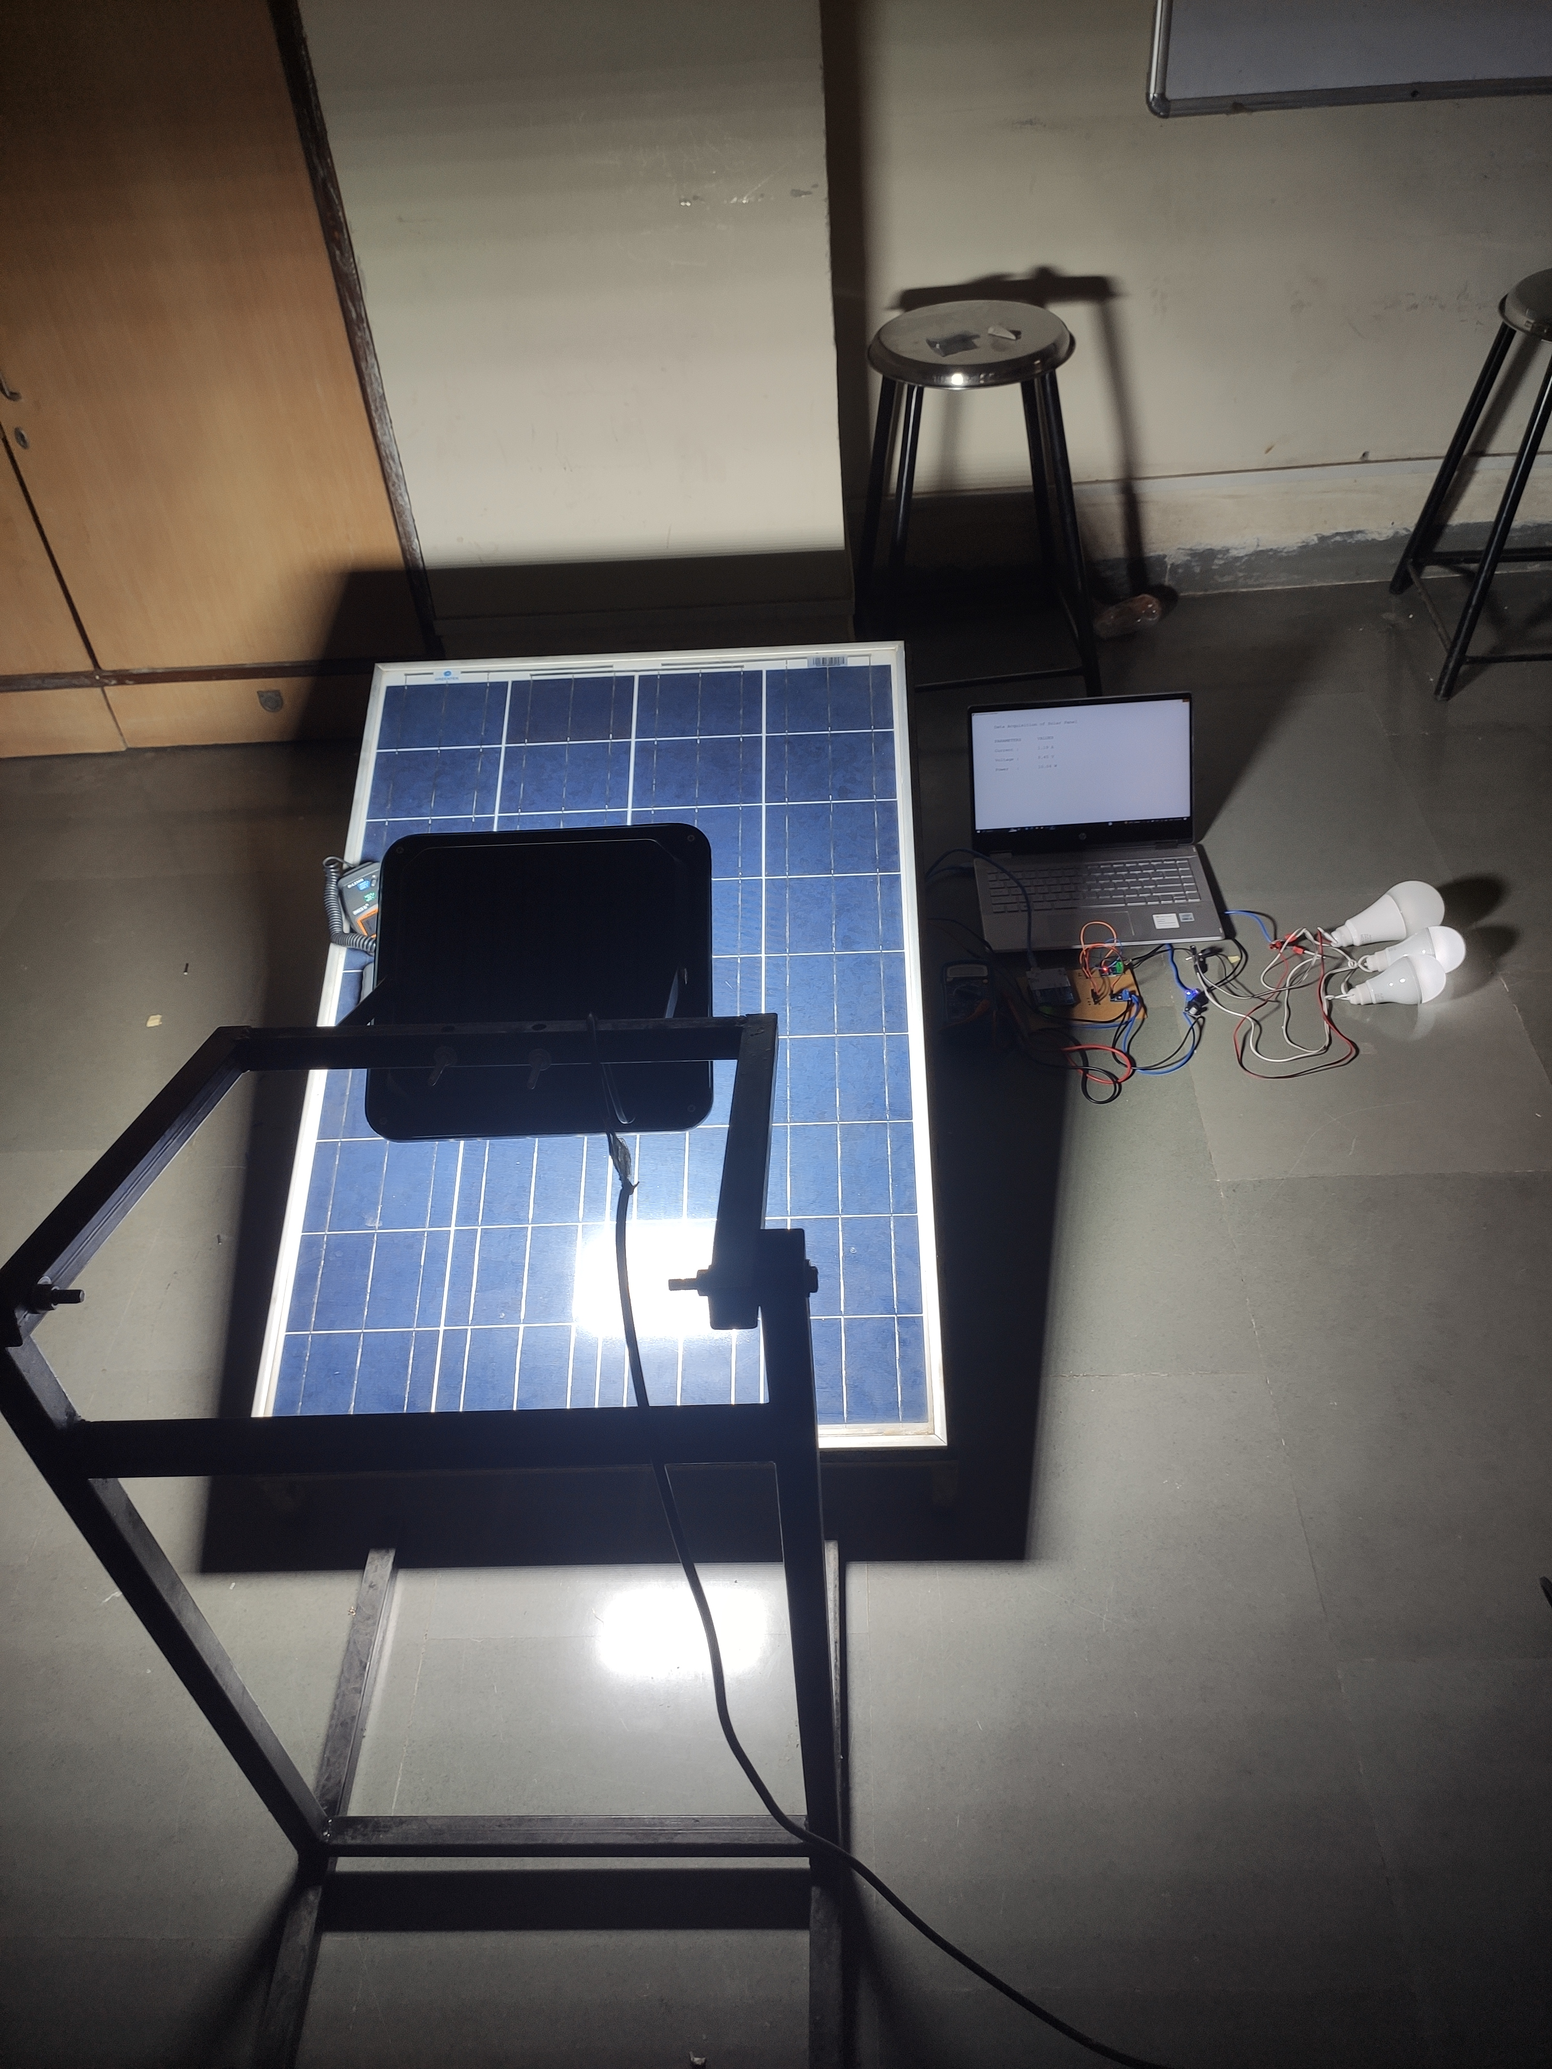
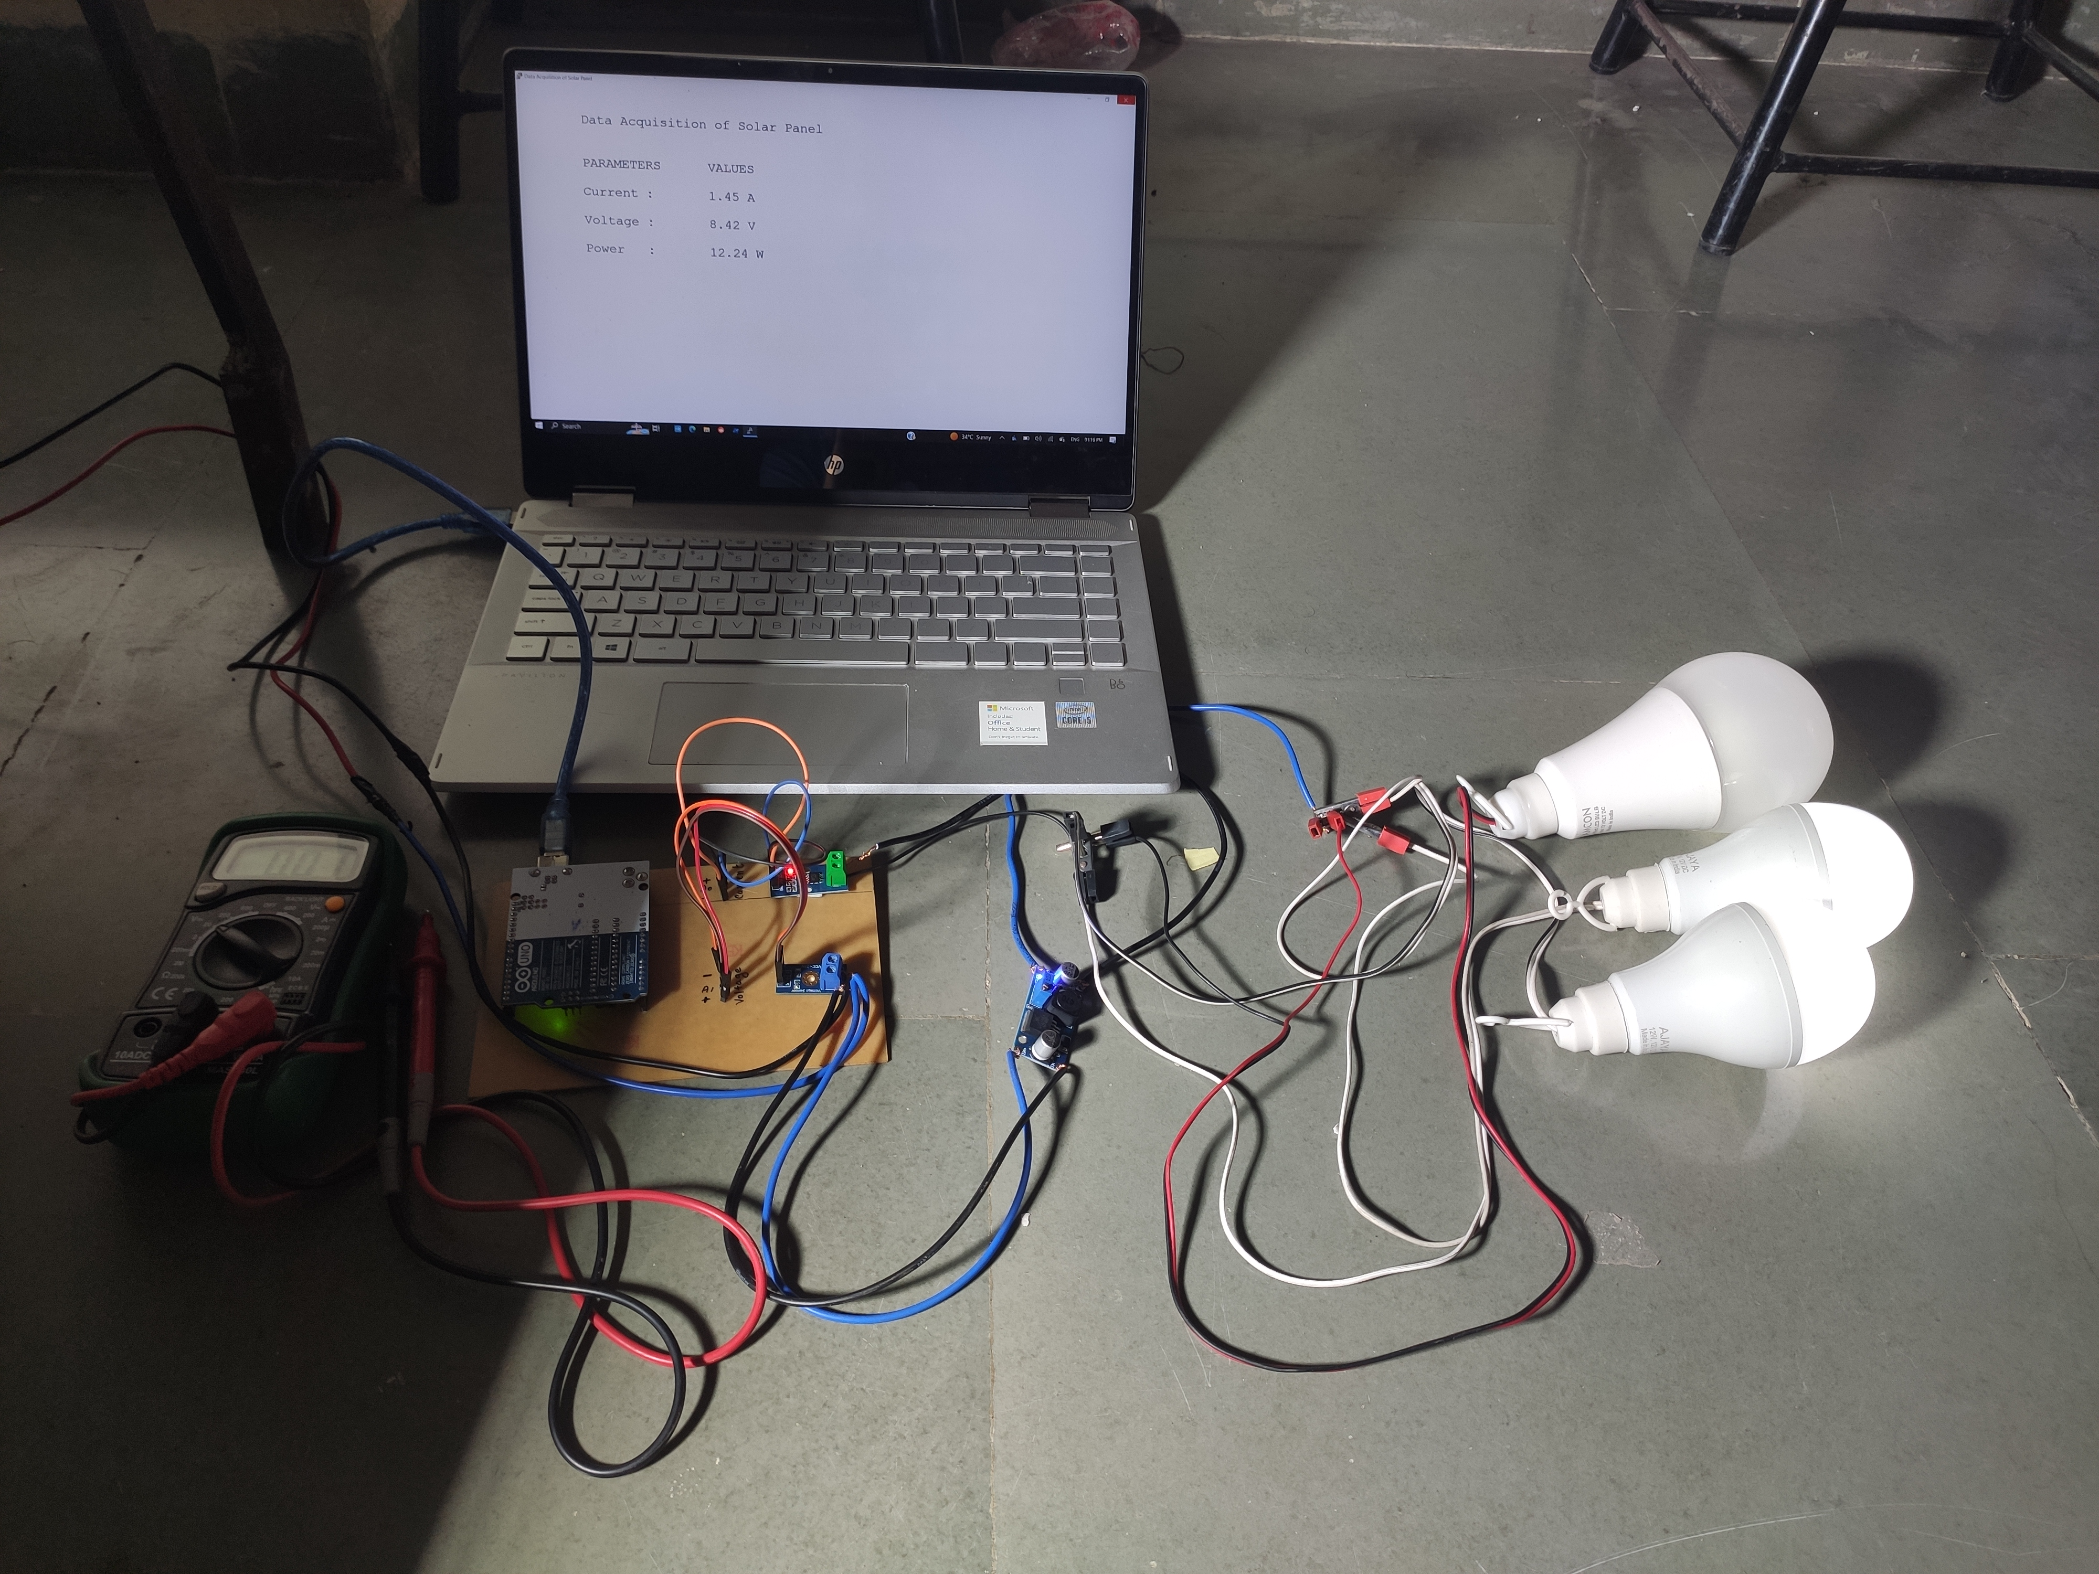
Hardware Setup
The setup shows solar panel receiving light from the flood light which further generates the power in Watts.
The setup shows significant irradiance being received by the solar panel. The GUI shows significant output generated by the system. The loads also satisfy the result by glowing.

Slide 17
Results
Sr. No. | Light Intensity (In LUX x 100) | Irradiance (In W/m2) | Voltage (In Volts) | Current (In Amps) | Practical Power (In Watts) | Simulated Power (In Watts)
1 | 10 | 7.9 | 2.33 | 0.01 | 0.03 | 0.17
2 | 20 | 15.8 | 5.5 | 0.03 | 0.19 | 0.39
3 | 30 | 23.7 | 7.9 | 0.15 | 1.2 | 1.23
4 | 40 | 31.6 | 8.10 | 0.32 | 2.65 | 1.66
5 | 50 | 39.5 | 8.25 | 0.38 | 3.18 | 2.8
6 | 60 | 47.4 | 8.45 | 0.45 | 3.80 | 3.59
The equation for power -
P = V. I
Irradiance (in W/m²) = Light Intensity (in Lux x 100) x 0.0079
Where,
P = Power
V = Output Voltage
I = Output Current

Slide 18
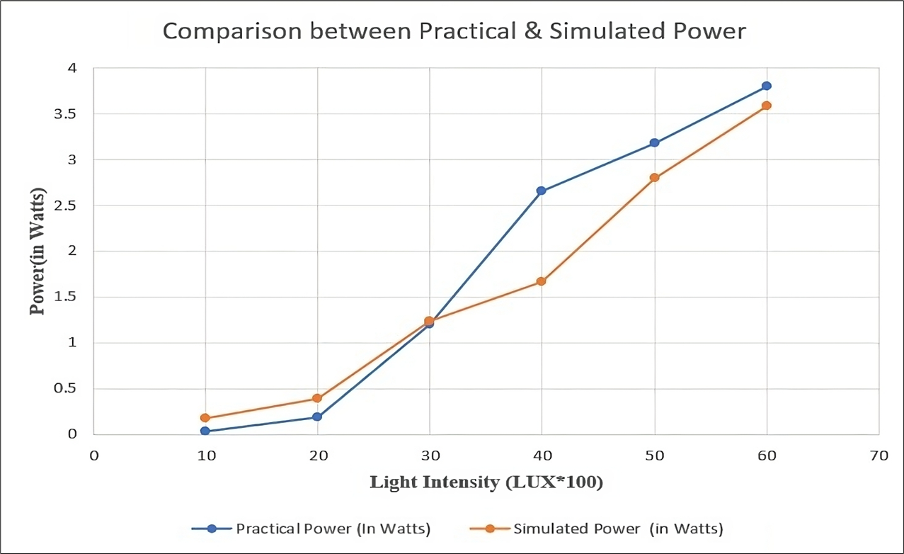
Results

Slide 19
Advantages
This system allows us to acquire real-time data related to the solar panel module and compare it with the simulated results.
The cost associated with operation and maintenance of solar panels accounts for about 15-20% of the overall energy generation cost which will be addressed.
Condition monitoring allows the implementation of predictive operation and maintenance strategies helping to reduce costs.
Data acquisition and visualization will help in using the data collected from sensors for productive application.

Slide 20
Applications
It helps to decide the feasibility of a solar power project. The analytical data generated can be used for well-grounded statistics.
By measuring average parameters of particular location, it can determine whether the location is suitable for setting up a solar plant.
It is useful for on ground workers to study the various parameters related to solar panel systems.
It can be used in commercial as well as household applications to collect data and analyze it.

Slide 21
Conclusion
The most promising renewable energy source, particularly for residential uses, is photovoltaic (PV) solar energy.
Solar powered devices are becoming more commercially purchasable as the price of PV generating system gradually drops.
Additionally, rising consumer knowledge is correlated with a higher willingness to pay for clean energy produced from renewable sources.
Consequently, a mechanism to gauge a location's capacity for solar energy production is required.
The technology meets these demands and will aid in spreading awareness of solar power among the general public.

Slide 22
References
V. Voicu, D. Petreus and R. Etz, "Data Acquisition System for Solar Panels," 2019 42nd International Spring Seminar on Electronics Technology (ISSE), 2019, pp. 1-6, doi: 10.1109/ISSE.2019.8810289.
M. Galád and P. Špánik, "Design of photovoltaic solar cell model for stand-alone renewable system", IEEE 10th International ELEKTRO Conference, pp. 285-288, 19 – 20 May 2014.
S. Lineykin, M. Averbukh and A. Kuperman, "Five-parameter model of photo voltaic cell based on STC data and dimensionless", 2012 IEEE 27th Convention of Electrical and Electronics Engineers in Israel, pp. 1-5, 2012.
D. Sera, R. Teodorescu and P. Rodriguez, "PV panel model based on datasheet values", Proc. IEEE Int. Symp. Ind. Electron., pp. 2392-2396, 2007.
V. Boscaino, G. Cipriani, V. Di Dio, R. Miceli and G. Capponi, "A simple and accurate model of photovoltaic modules for power system design," 2014 Ninth International Conference on Ecological Vehicles and Renewable Energies (EVER), 2014, pp. 1-6, doi: 10.1109/EVER.2014.6844088.

Slide 23
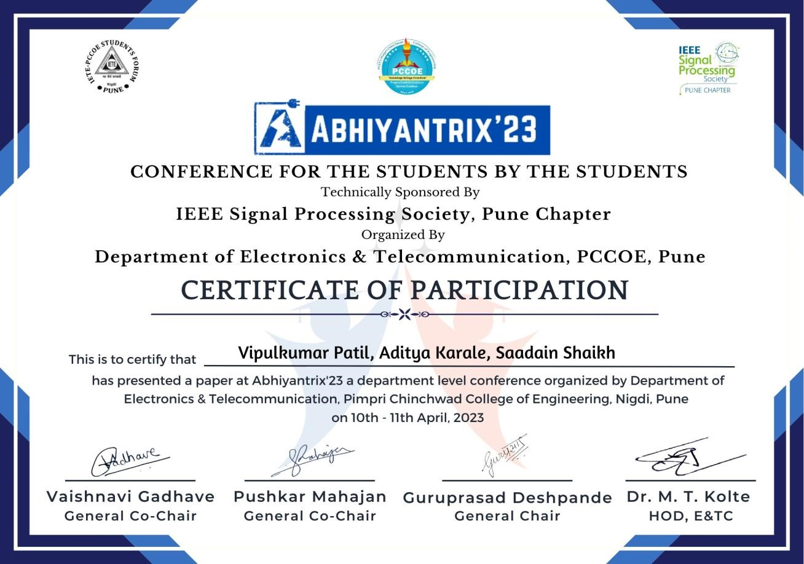
Project Outcome

Slide 24
THANK YOU

